Slide 1
POKEMART
Implementation of an e-commerce based application particularly selling Pokèmon figurines.
Solution: PokeMart is a website where you can buy all kinds of Pokémon Figurines in one place.
Goal: We want to make it super easy for everyone to shop for Pokémon Figurines.
Samuel Richardson
Javeria khan
Promodi Colambage
Team Rocket:

Slide 2
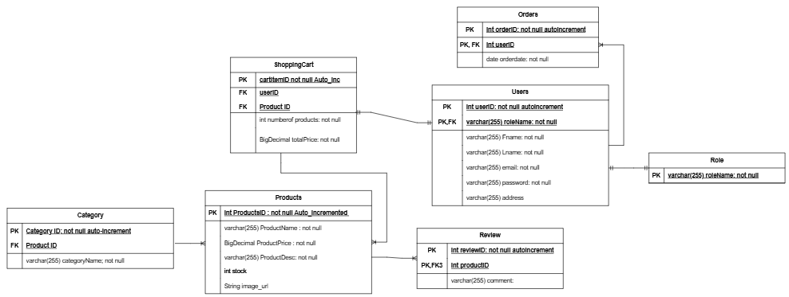
POKEMART ERD Diagram

Slide 3

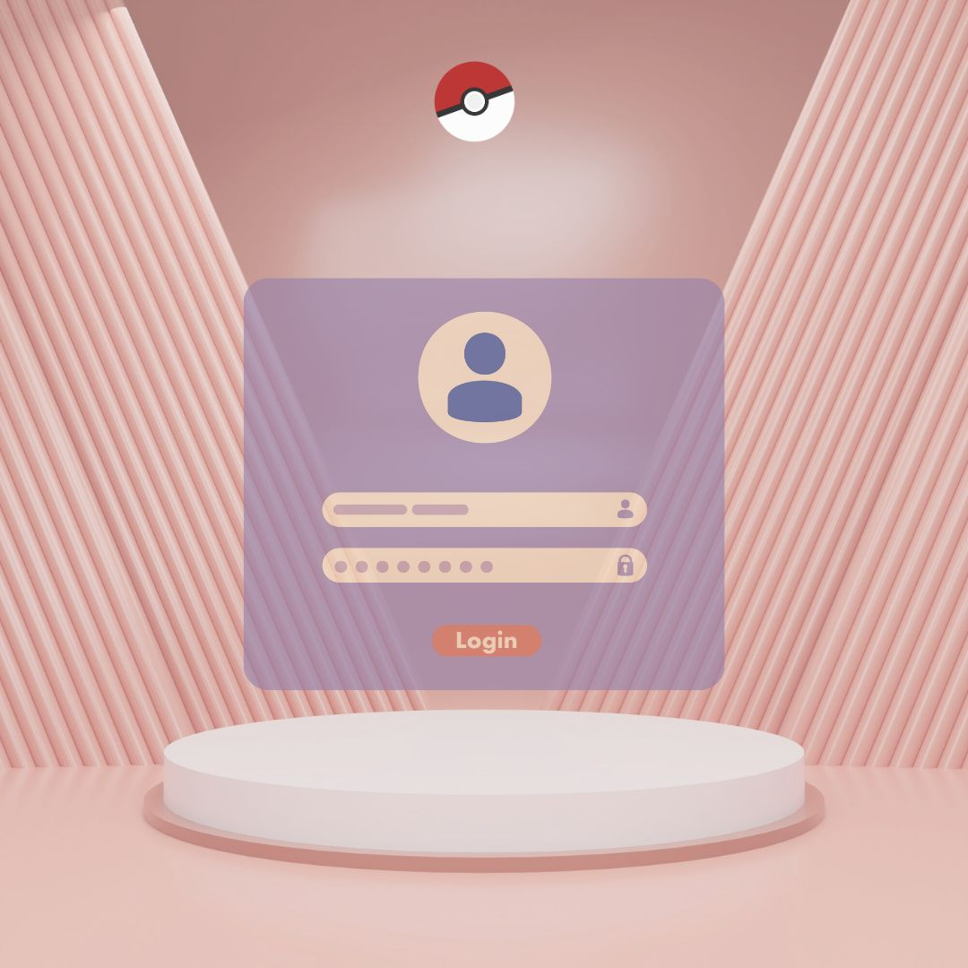
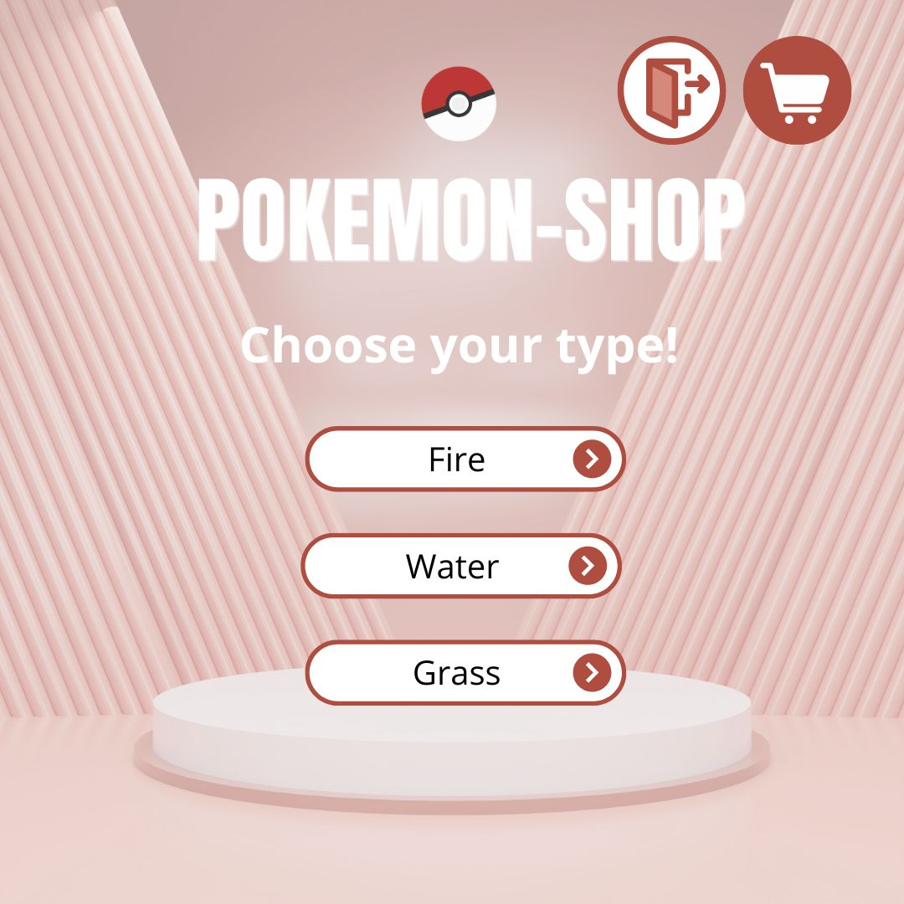
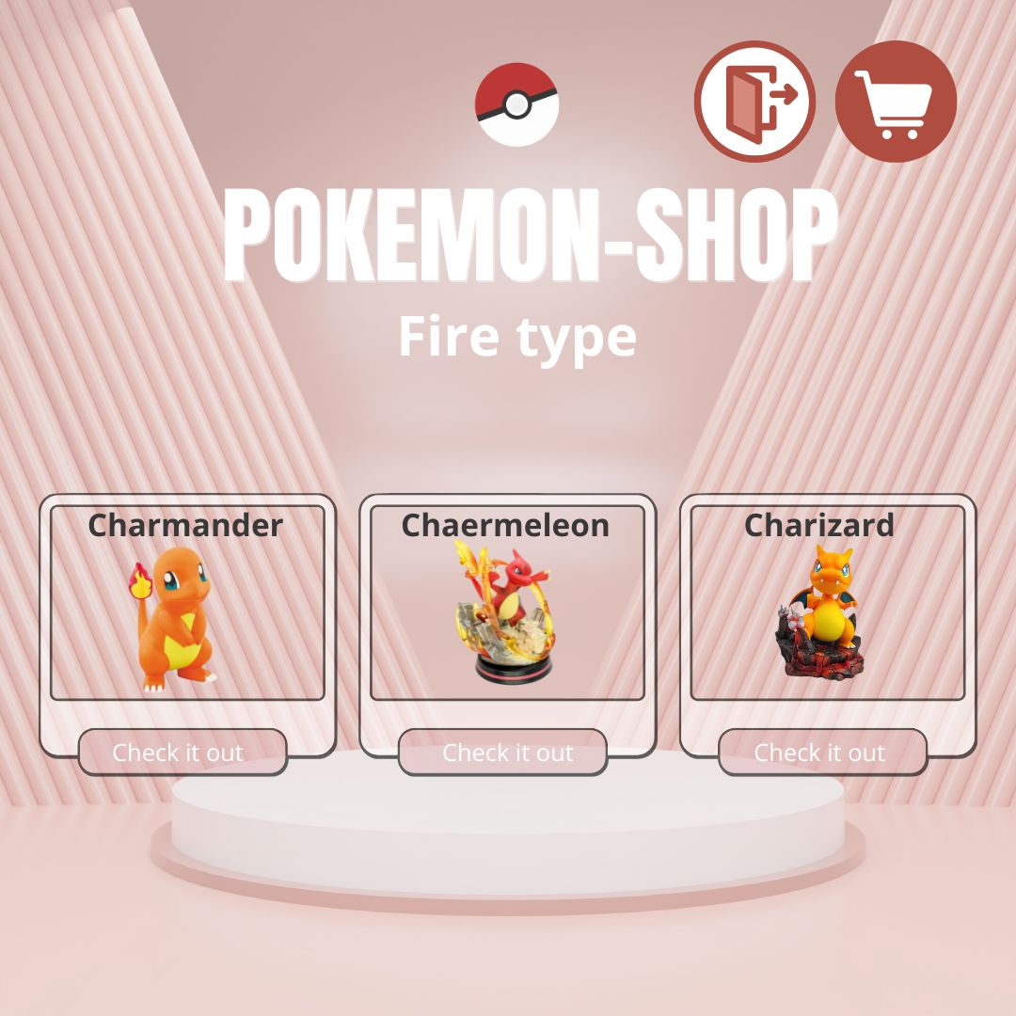
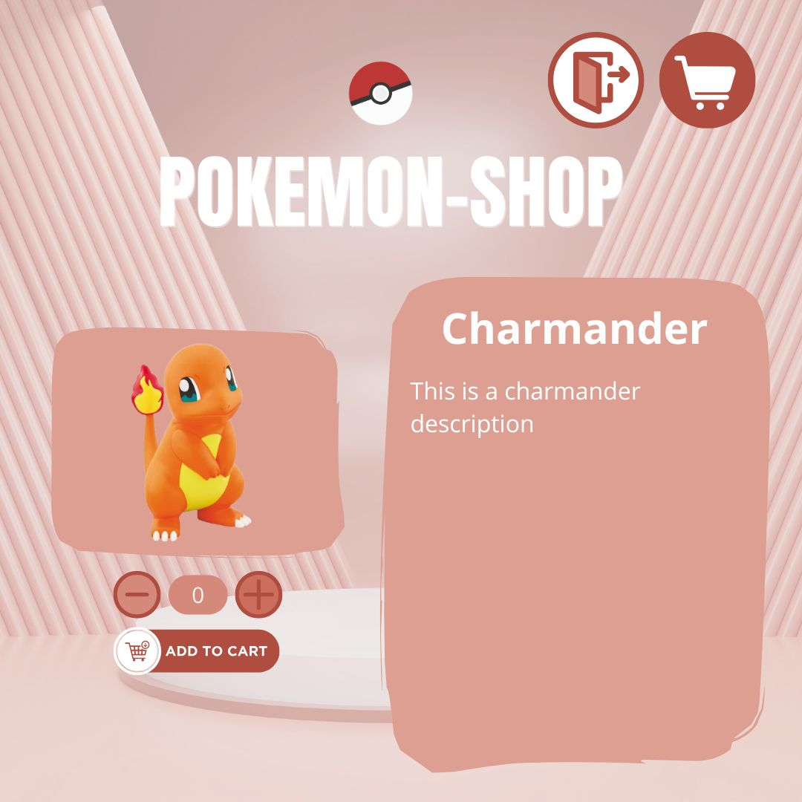
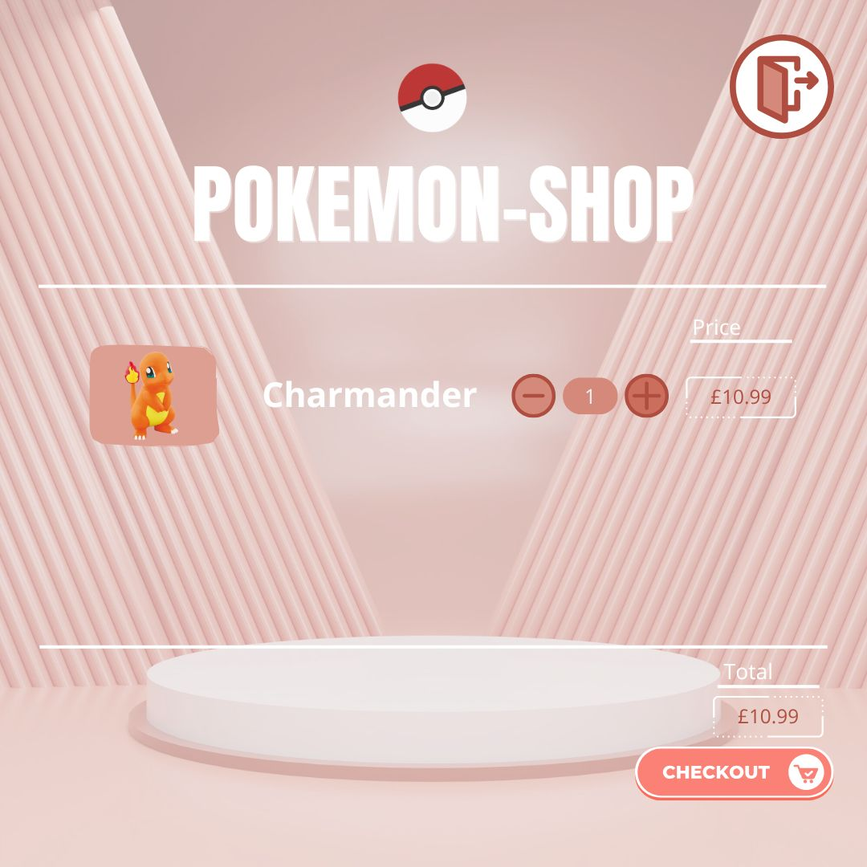
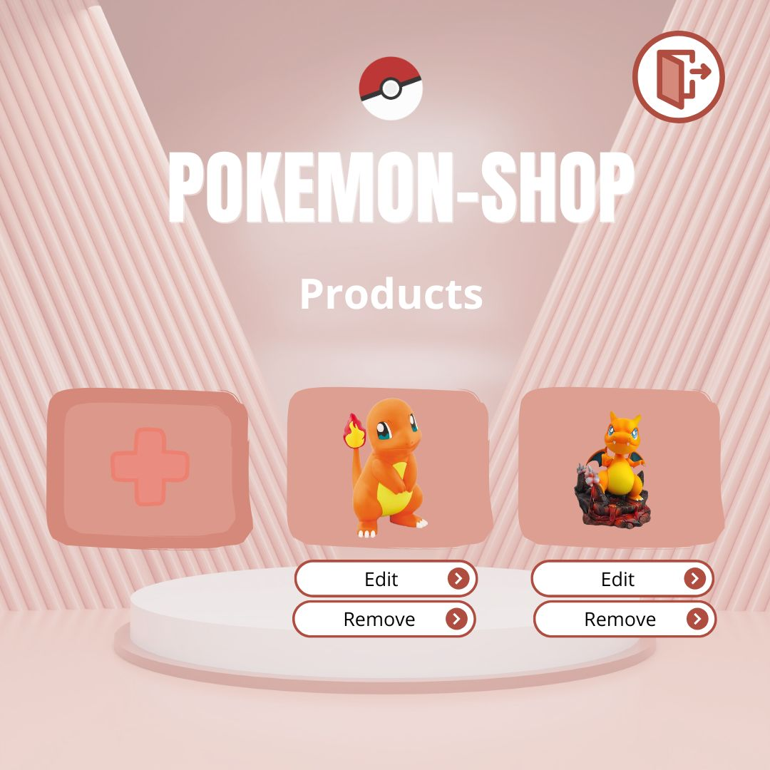
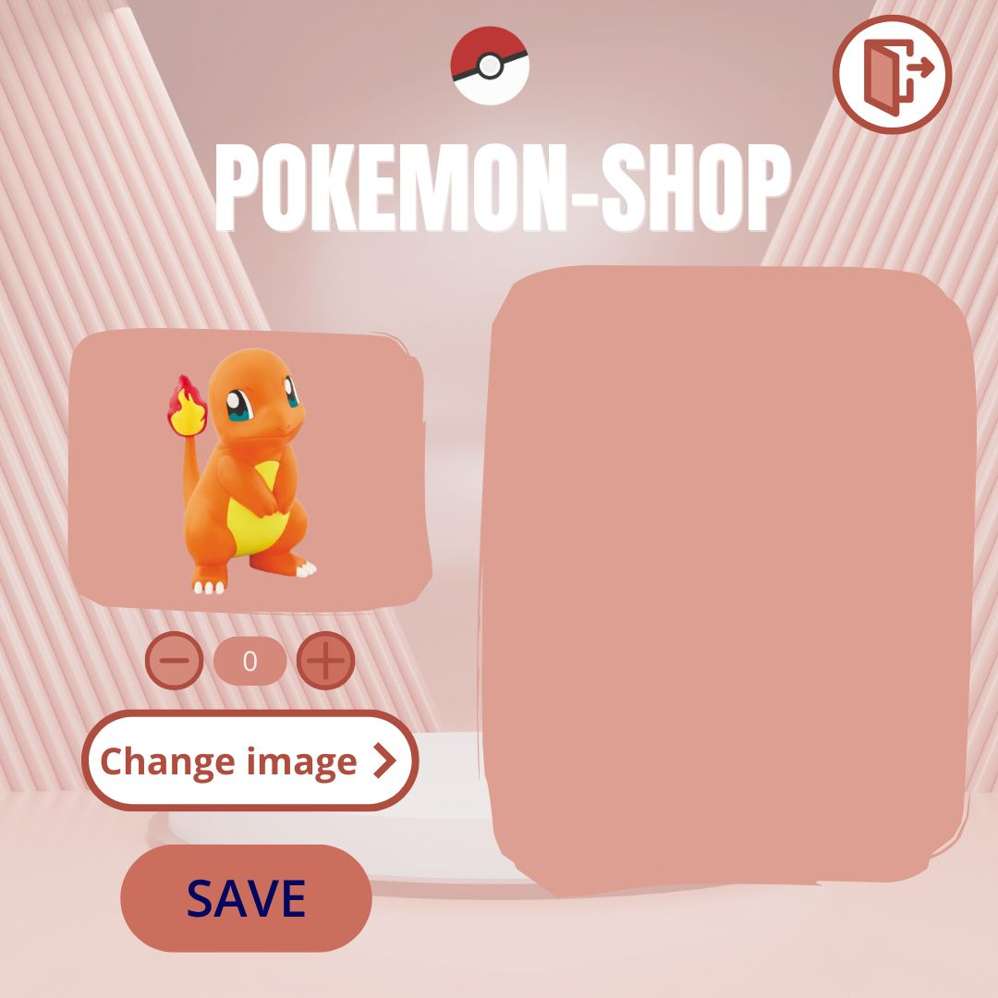
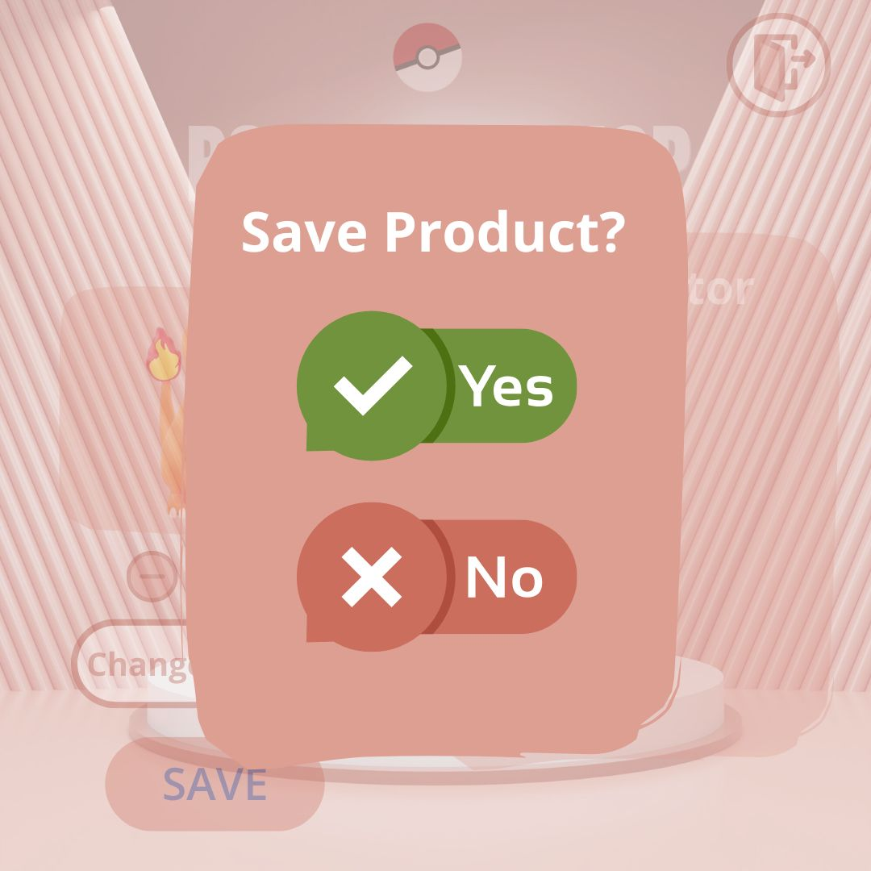
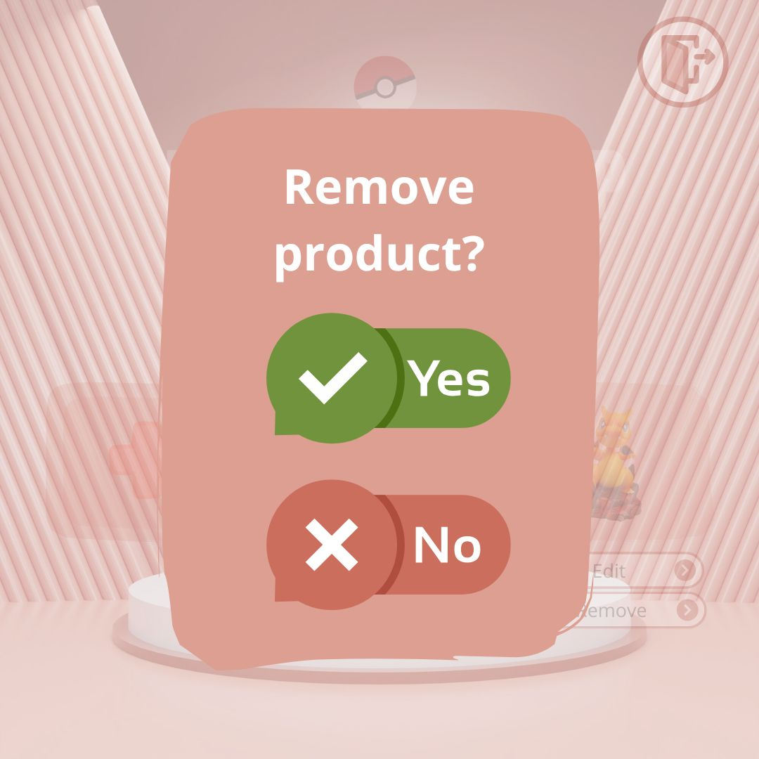
WireFrames

Slide 4
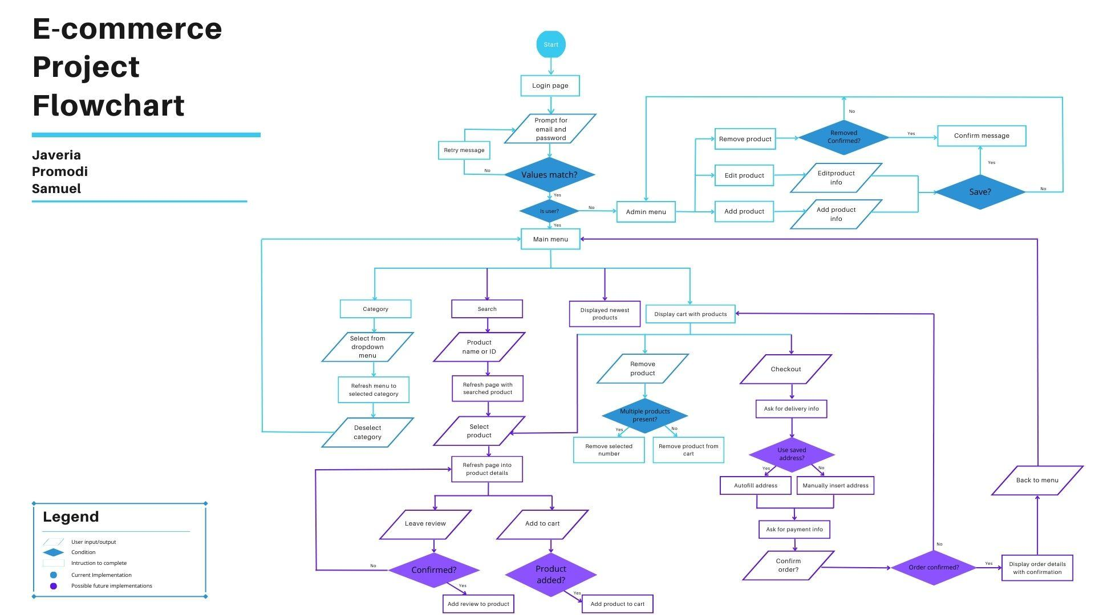

Slide 5
Technology Stacks
Frontend
React: Helps create the website layout and interactions.
HTML & CSS: Structure and design of the web pages.
JavaScript : Adds functionality to the site (like buttons and forms).
Backend
Java (MVC Spring Boot): Handles requests from the frontend.
JPA: Relation data management and mapping.
REST API Architecture: Connects the frontend and backend to send & receive data.
Database
SQL (MySQL Workbench): Stores user data and other information.

Slide 6
Functionality of Application
Login and Logout
Users enter their email address & password to log in. Clicking the logout button will log them out and return them to the home screen.
Category
Display available product types.
Once a type is selected display products only of that type.
Shopping Cart
User can add selected Products to the shopping cart
User can edit the number of specific products in that cart
User can remove products from the cart
User can checkout all the items
Admin CRUD Operations (Create, Read, Update, Delete)
Create: Admin can add a new product by filling in details (name, price, stock, description, and image).
Read: Users can view all products listed in the store.
Update: Admin can edit a product (change price, stock, or description).
Delete: Admin can remove a product.

Slide 7
Issues and Improvements
Git & Repository Conflicts
Faced issues pushing code due to conflicts in the repository.
Used git pull before pushing and carefully resolved merge conflicts.
For the future we could use different branches.
Add Reviews
Implement a customer review feature where users can rate and review products.
Display reviews on product pages to help future buyers.
Implement Mobile Version
Improve user interface so the app works well on different devices.
Security
Have a more secure Login Authentication and Implement a user registration form.

Slide 8
Lesson Learnt
Project Management
Adaptability
Teamwork
Communication
Learning new technologies
Continuous Improvement

